Slide 1

Speak fluently
Intermediate

Slide 2
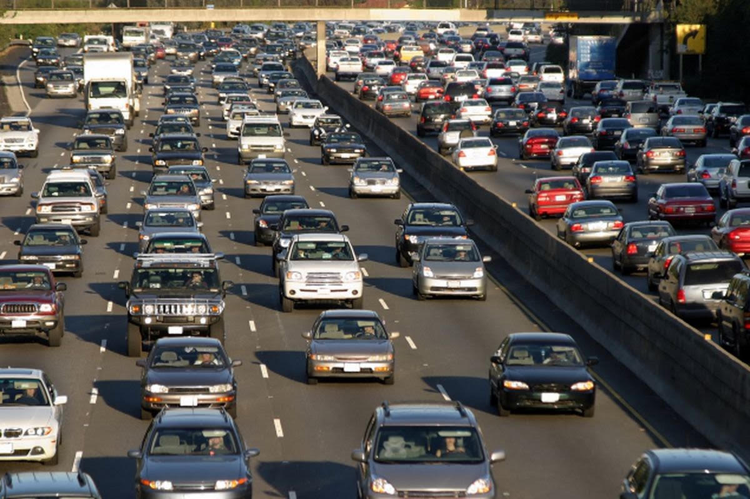
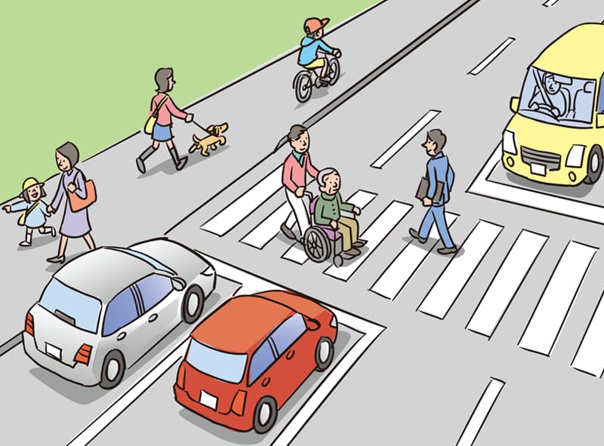
15. Driving

Slide 3
15. Driving
(1) When do you think people should be allowed to drive a car?
What do you think of the driving in other countries?
How often do you think people need to renew their driving licence or driving skills?
What should governments do to make driving safer?
Do you prefer to drive or travel by another form of transport?
What do other people think of or say about your driving?
What do you think the punishment for drunk driving should be?
Do you think drivers should be tested frequently to continually improve their driving skills?
Do you think men or women are the best drivers?
(10) If you went on a driving holiday, where would you like to go?

Slide 4
15. Driving
11- Do you like driving / sitting in a car?
12- Have you ever been in / had / seen a driving accident?
13- Do you think driving is dangerous?
14- What’s the most dangerous piece of driving you’ve ever seen?
15-Do you (or someone you know well) always follow the rules of the road when you (they) drive?
16- What do you think about when you drive?
17- Do you think you are a good or a bad driver?
18-Do you think there should be more rules for drivers in your country? 19- What kind of car do you prefer? What is your dream car? 20-Do you have a GPS? If yes, when do you use it? If no, would you like one? Why or why not?

Slide 5
15. Driving
21- How old were you when you first learned to drive?
22- Was there anything difficult about learning to drive?
23- Can you drive a manual shift car?
24- Which do you like best, a standard or an automatic shift car?
25- Are the drivers in your area where you live good drivers?
26- Do you know anything about repairing or maintaining a car?
What do you know how to do?
Where did you learn how to do this?
27- Do you enjoy repairing cars?
What are some things you do to maintain your car?
28- Do you prefer driving or riding public transportation?
29- Do you like to drive at night? Why?
30- At what age can you get a license where you live?

Slide 6
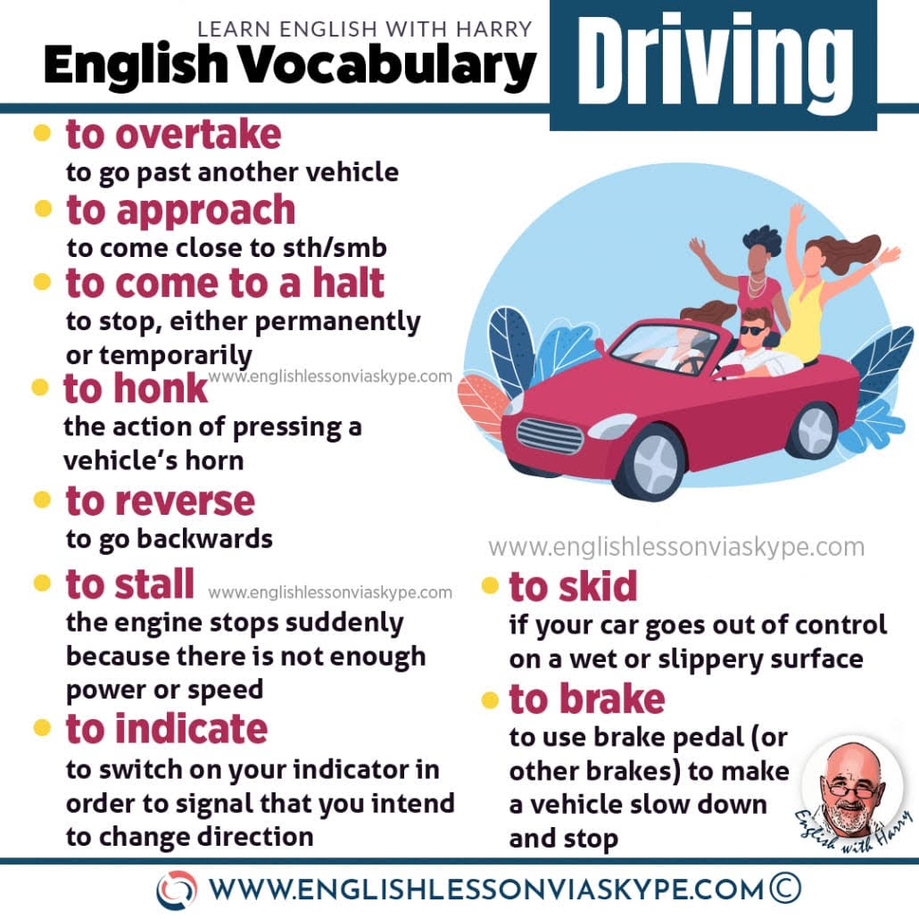
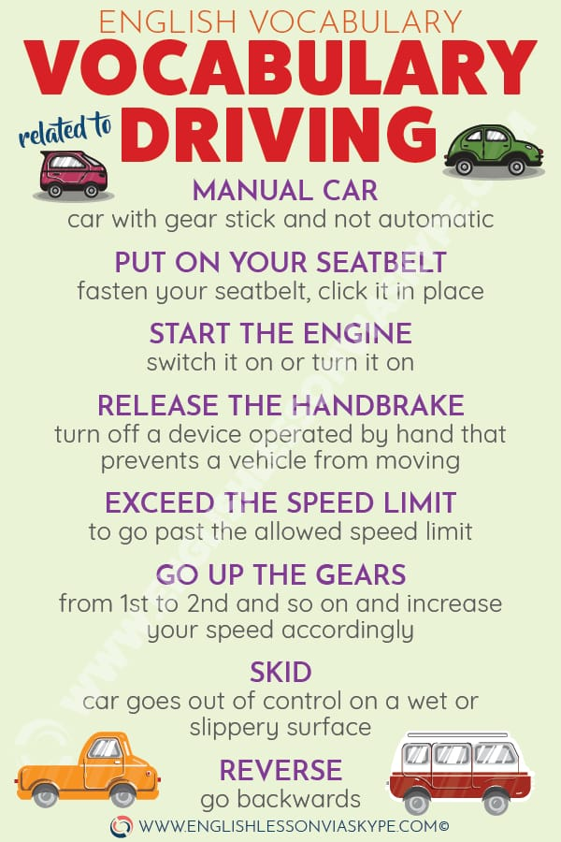
15. Driving

Slide 7
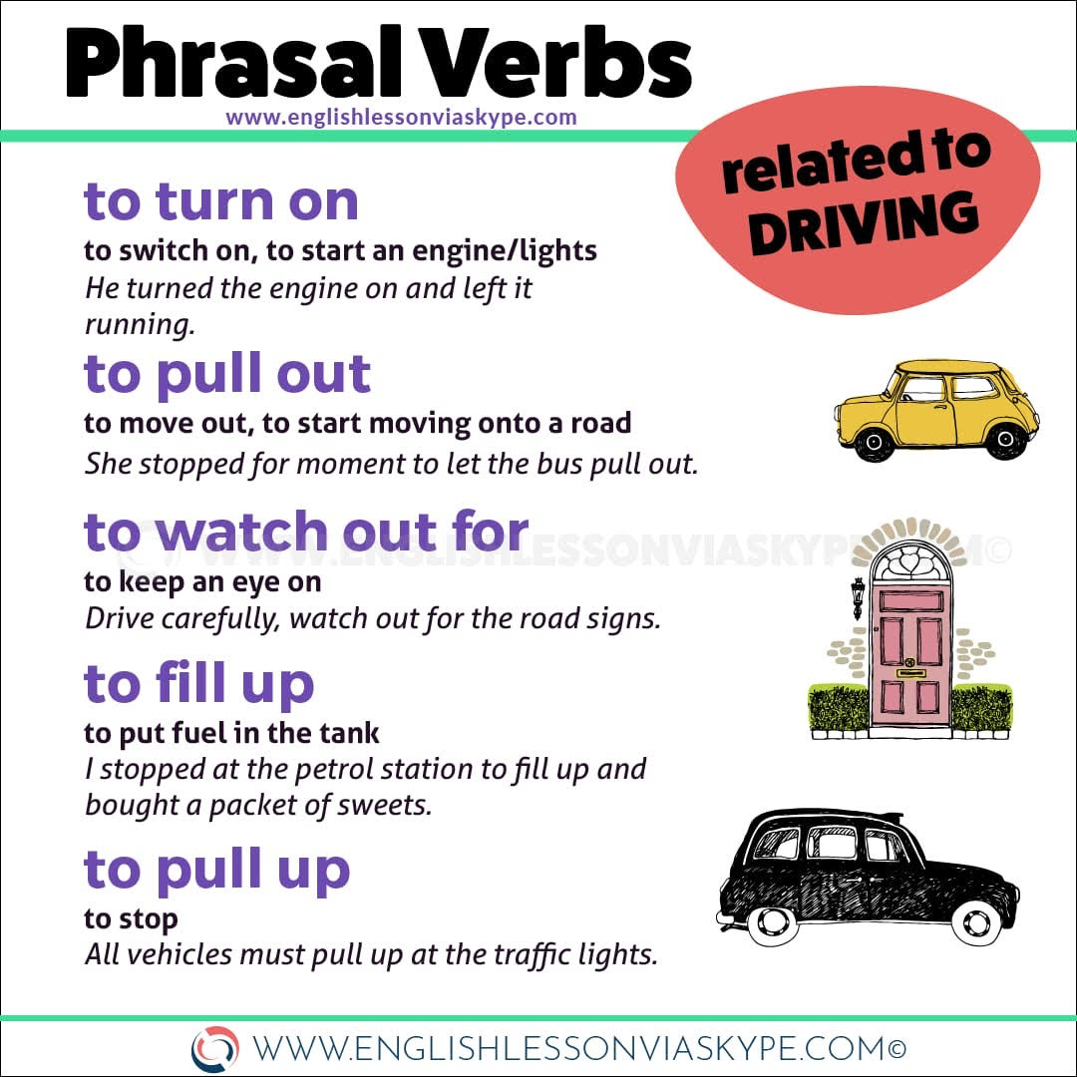
15. Driving

Slide 8
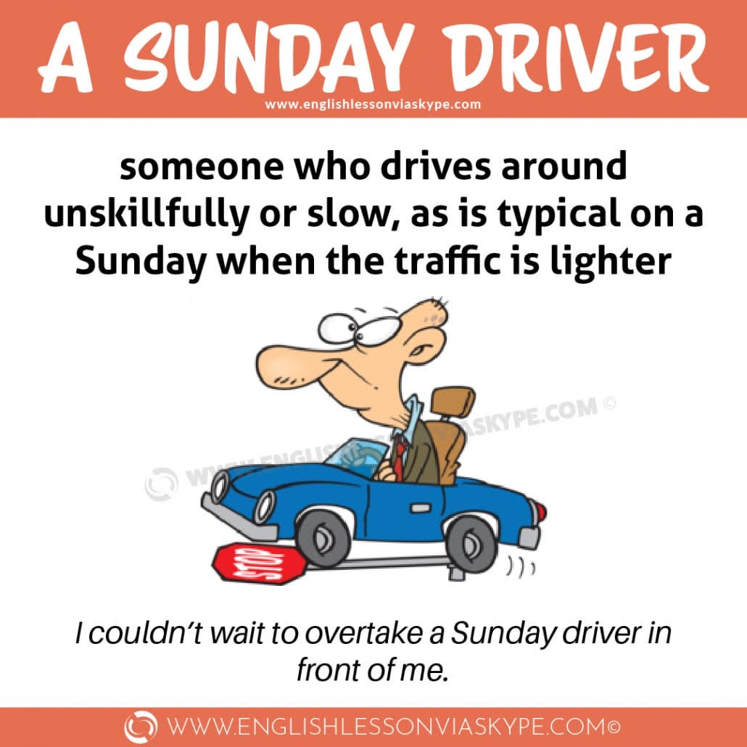
15. Driving
Idioms

Slide 9
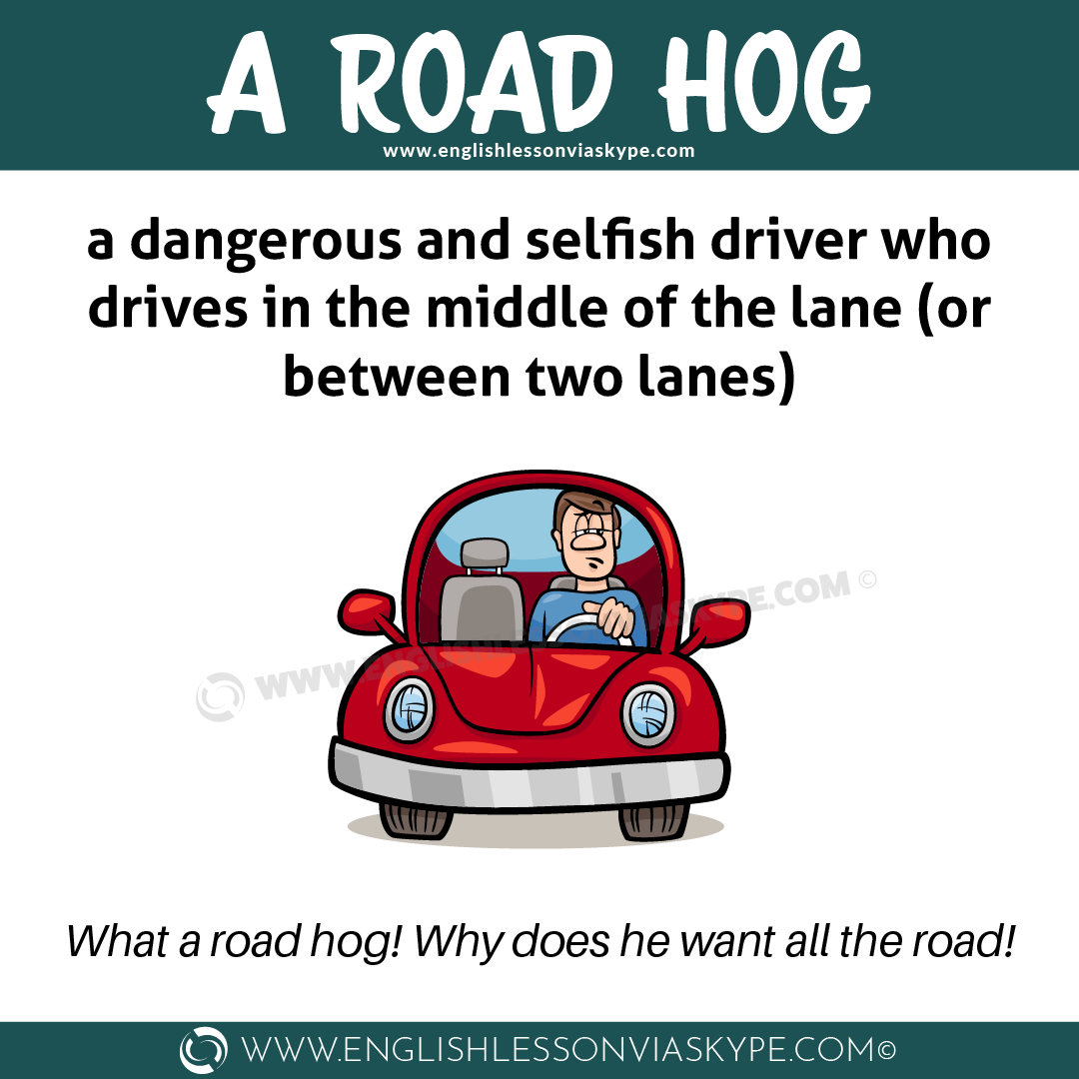
15. Driving
idioms

Slide 10
15. Driving
Idioms:
In the driving seat
When you are in the driving seat, you are in control of a situation.
"During negotiations, he felt he was in the driving seat."
The driving force
The driving force behind someone or something is the person or thing that motivates and directs it.
"His wife was the real driving force behind his success."
Driving blind
You drive blind when you are unable to see ahead or when you don't have enough knowledge about something.
We were young and unexperienced when we started the business. We were driving blind for the first few years.

Slide 11
15. Driving
Idioms:
Drive up the wall/ drive round the bend/ drive crazy
These three idioms all refer to something that annoys or irritates us.
My neighbor's dog barking is driving me up the wall.
It drives me round the bend when you leave dirty dishes in the sink.
People who eat with their mouths open drive me crazy.
Drive home
When you drive something home, you say something clearly and with force so people understand.
To drive home his point he repeated the sentence.

Slide 12
15. Driving
Idioms:
Drive up/ down the price
When something drives up or down the price, it forces it up or down.
The high demand for this product has driven the price up.
The new airport in the city is so noisy, it's driven down house prices in the area.
What are you driving at?
When you ask someone what they really mean, you ask them what they are driving at.

